Slide 1
Knowledge Management
Web Portal
Indian Foods
S. No. | SRN | Name
1 | PES1201802121 | Mohammad Shahrukh
2 | PES1201802123 | Pranjal Mathur
3 | PES1201802387 | Keerthana O
4 | PES1201802426 | Aishwarya D
5 | PES1201802417 | Akshay Kadam
Group No. : 6

Slide 2
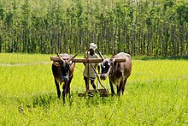
INDIAN AGRICULTURE
The history of Agriculture in India dates back to Indus Valley Civilization and even before that in some places of Southern India. India ranks second worldwide in farm outputs. As per 2018, agriculture employed more than 50℅ of the Indian work force and contributed 17–18% to country's GDP.
India's agriculture is composed of many crops, with the foremost food staples being rice and wheat. Indian farmers also grow pulses, potatoes, sugarcane, oilseeds, and such non-food items as cotton, tea, coffee, rubber, and jute (a glossy fiber used to make burlap and twine). India is a fisheries giant as well. A total catch of about 3 million metric tons annually ranks India among the world's top 10 fishing nations.

Slide 3
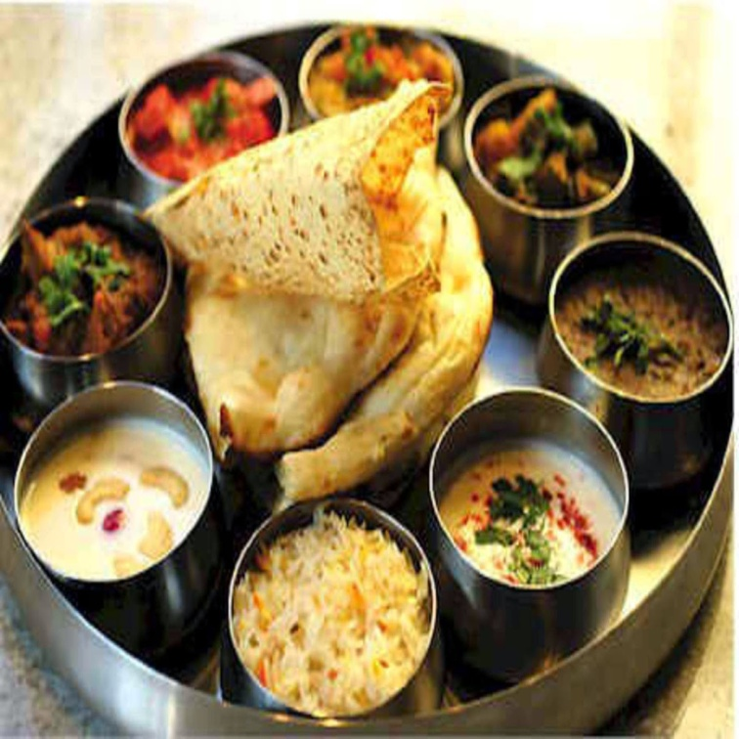
• North India: Awadhi – Bihari – Bhojpuri -Kashmiri Punjabi – Rajasthani – Uttar Pradeshi –Mughlai • South India: Andhra – Karnataka – Kerala – Tamil Hyderabadi – Udupi • East India: Bengali – Oriya - West Bengal • North-East India: Assamese – Naga –sikkime Tripuri • West India: Goan – Gujarati – Marathi –Parsi Malvani & Konkani
TYPES OF INDIAN FOOD

Slide 4
North Indian Cuisine
North cuisine is a part of cuisine, from the region of Northern India which include cuisines of Jammu and Kashmir, Punjab, Chandigarh, Haryana, Himachal Pradesh, Rajasthan, Uttarakhand, Delhi, Uttar Pradesh, Bihar, Jharkhand, Madhya Pradesh and Chhattisgarh.
Staple diet of the people of these states is rice, pulses and vegetables. However, the method of preparation differs.
There are also some special recipes of each region which are famous throughout the country like Rajasthan Dal Bati, Uttar Pradesh's Kebabs and Punjab's Sarson Ka Saag and Makki di Roti. North India also boasts of the world famous Mughlai cuisine which you will definitely appreciate.

Slide 5
South Indian Cuisine
South Indian Cuisine includes the cuisines of the five southern states of India—Andhra Pradesh, Karnataka, Kerala, Tamil Nadu and Telangana—and the union territories of Lakshadweep, Pondicherry, and the Andaman and Nicobar Islands.
There are typically vegetarian and non-vegetarian dishes for all five states. Additionally, all regions have typical main dishes, snacks, light meals, desserts, and drinks that are well known in their respective region.. Offlate many of the recipes of the south India have become quite popular with not only the rest of Indians but also with the foreigners. Some of these recipes include idli, dosa, uppuma, pongal and sambhar. These dishes will delight you with their taste and flavour.

Slide 6
Ingredients of Indian Foods
Staple foods of Indian cuisine include pearl millet (bajra), rice, whole-wheat flour (atta), and a variety of lentils, such as masoor (most often red lentils), tuer (pigeon peas), urad (black gram), and moong (mung beans). Lentils may be used whole, dehusked—for example, dhuli moong or dhuli urad—or split. Split lentils, or dal, are used extensively. Some pulses, such as channa or cholae (chickpeas), rajma (kidney beans), and lobiya (black-eyed peas) are very common, especially in the northern regions. Channa and moong are also processed into flour (besan).
Many Indian dishes are cooked in vegetable oil, but peanut oil is popular in northern and western India, mustard oil in eastern India, and coconut oil along the western coast, especially in Kerala and parts of southern Tamil Nadu. Gingelly (sesame) oil is common in the south since it imparts a fragrant, nutty aroma. In recent decades, sunflower, safflower, cottonseed, and soybean oils have become popular across India. Hydrogenated vegetable oil, known as Vanaspati ghee, is another popular cooking medium. Butter-based ghee, or desi ghee, is used frequently, though less than in the past.
Many types of meat are used for Indian cooking, but chicken and mutton tend to be the most commonly consumed meats. Fish and beef consumption are prevalent in some parts of India, but they are not widely consumed except for coastal areas, as well as the north east.

Slide 7
THANK YOU

